Slide 1

AI Mental Health Therapist
With Google MedGemma LLM
AI Doctor 4.0
(SafeSpace)

Slide 2











Tech Stack
Health-care based LLM from Google (MedGemma Family)
LLMs
Ollama
API usage (GPT-4/Claude/Groq/etc)
AI Chatbot development (langgraph, langchain, etc)
AI Agents & Agentic Workflow
Streamlit (Frontend)
FastAPI (Backend)
Tools for AI Agent
Emergency calls with Twilio
Location services
Professional support

Slide 3
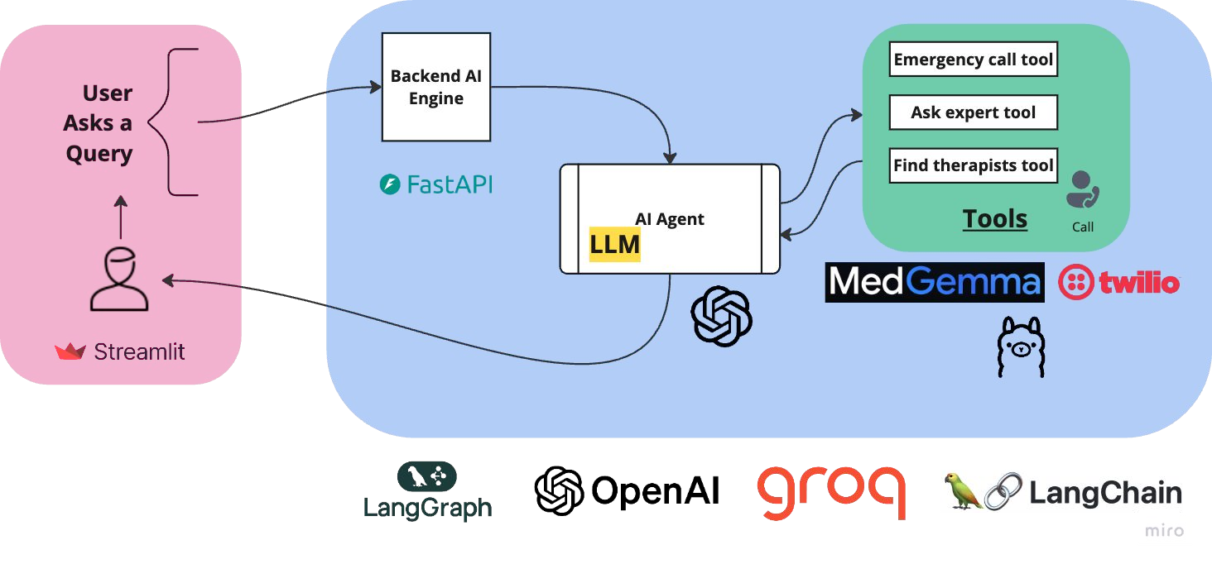
Technical Architecture

Slide 4
Code Setup
Phase 1: Setup Frontend
Setup Streamlit
User is able to ask question
Show response from backend
Phase 2: Setup Backend
Setup FastAPI backend
Receive and validate request from Frontend
Send response to the frontend
Phase 3: Setup AI Agent & Tools
Setup Ollama with Medgemma tool
Setup Twilio calling API tool
Setup Location tool
Create an AI Agent & Link to backend
Phase 4: Test everything together

